Slide 1

Libranner L. Santos Espinal
Ingeniero de Software
Senior iOS Developer
Más de 9 años de experiencia en desarrollo de Software.
4 años de experiencia en desarrollo de aplicaciones móviles iOS.
Notes:
Buenos días

Slide 2

Swift 101

Slide 3



Acerca de Swift
Orígenes
Características
Usos
Situación Actual
Notes:
Primera aparición en Junio del 2012
Release estable 2.2
Próxima versión 3
The features of Swift are designed to work together to create a language that is powerful, yet fun to use. Some additional features of Swift include:
Closures unified with function pointers
Tuples and multiple return values
Generics
Fast and concise iteration over a range or collection
Structs that support methods, extensions, and protocols
Functional programming patterns, e.g., map and filter
Powerful error handling built-in
Advanced control flow with do, guard, defer, and repeat keywords
Optionals
IBM: https://swiftlang.ng.bluemix.net/#/repl, Kitura Web Framework

Slide 4
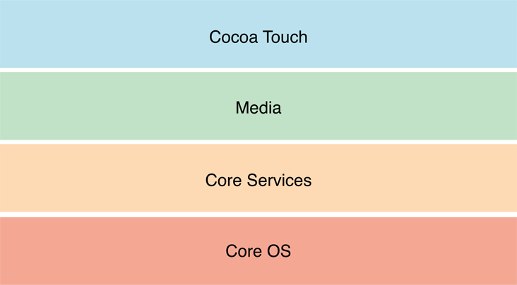
Arquitectura IOS
Notes:
1. Core OS Layer:
The Core OS layer holds the low level features that most other technologies are built upon.
Core Bluetooth Framework.
Accelerate Framework.
External Accessory Framework.
Security Services framework.
Local Authentication framework.
64-Bit support from IOS7 supports the 64 bit app development and enables the application to run faster.
2. Core Services Layer
Some of the Important Frameworks available in the core services layers are detailed:
Address book framework – Gives programmatic access to a contacts database of user.
Cloud Kit framework – Gives a medium for moving data between your app and iCloud.
Core data Framework – Technology for managing the data model of a Model View Controller app.
Core Foundation framework – Interfaces that gives fundamental data management and service features for iOS apps.
Core Location framework – Gives location and heading information to apps.
Core Motion Framework – Access all motion based data available on a device. Using this core motion framework Accelerometer based information can be accessed.
Foundation Framework – Objective C covering too many of the features found in the Core Foundation framework
Healthkit framework – New framework for handling health-related information of user
Homekit framework – New framework for talking with and controlling connected devices in a user’s home.
Social framework – Simple interface for accessing the user’s social media accounts.
StoreKit framework – Gives support for the buying of content and services from inside your iOS apps, a feature known asIn-App Purchase.
3. Media Layer: Graphics, Audio and Video technology is enabled using the Media Layer.
Graphics Framework:
UIKit Graphics – It describes high level support for designing images and also used for animating the content of your views.
Core Graphics framework – It is the native drawing engine for iOS apps and gives support for custom 2D vector and image based rendering.
Core Animation – It is an initial technology that optimizes the animation experience of your apps.
Core Images – gives advanced support for controling video and motionless images in a nondestructive way
OpenGl ES and GLKit – manages advanced 2D and 3D rendering by hardware accelerated interfaces
Metal – It permits very high performance for your sophisticated graphics rendering and computation works. It offers very low overhead access to the A7 GPU.
Audio Framework:
Media Player Framework – It is a high level framework which gives simple use to a user’s iTunes library and support for playing playlists.
AV Foundation – It is an Objective C interface for handling the recording and playback of audio and video.
OpenAL – is an industry standard technology for providing audio.
Video Framework
AV Kit – framework gives a collection of easy to use interfaces for presenting video.
AV Foundation – gives advanced video playback and recording capability.
Core Media – framework describes the low level interfaces and data types for operating media.
Cocoa Touch Layer
EventKit framework – gives view controllers for showing the standard system interfaces for seeing and altering calendar related events
GameKit Framework – implements support for Game Center which allows users share their game related information online
iAd Framework – allows you deliver banner-based advertisements from your app.
MapKit Framework – gives a scrollable map that you can include into your user interface of app.
PushKitFramework – provides registration support for VoIP apps.
Twitter Framework – supports a UI for generating tweets and support for creating URLs to access the Twitter service.
UIKit Framework – gives vital infrastructure for applying graphical, event-driven apps in iOS. Some of the Important functions of UI Kit framework:
-Multitasking support.
– Basic app management and infrastructure.
– User interface management
– Support for Touch and Motion event.
– Cut, copy and paste support and many more.

Slide 5
Swift vs Objective-C
Ventajas
Más fácil de aprender (a menos que vengas de C)
Es más “seguro”
Es Open Source
Swift es el futuro
Playground
Más rapido *
Desventajas
Solo puedes usarlo a partir de iOS 7
El manejo de errores no es el más claro
Puede que algunas API todavía no hayan migrado
IDE todavía con menos soporte
According to Primate Labs, makers of the popular GeekBench performance tool, Swift was approaching the performance characteristics of C++ for compute-bound tasks in December 2014 using the Mandelbrot algorithm. In February 2015, Primate Labs discovered that the Xcode 6.3 Beta improved Swift’s performance of the GEMM algorithm -- a memory-bound algorithm with sequential access of large arrays -- by a factor of 1.4. The initial FFT implementation -- a memory-bound algorithm with random access of large arrays -- had a 2.6-fold performance improvement.

Slide 6



Swift vs otras alternativas
Rendimiento (especialmente en los casos que no compila a código nativo).
En el caso de las aplicaciones híbridas usando HTML5 y JS la experiencia de usuario no es la misma, las aplicaciones corren sobre un web browser.
Acceso a las librerías es más facil y rápido.
No garantiza el soporte para librerías de terceros basadas en Swift.

Slide 7
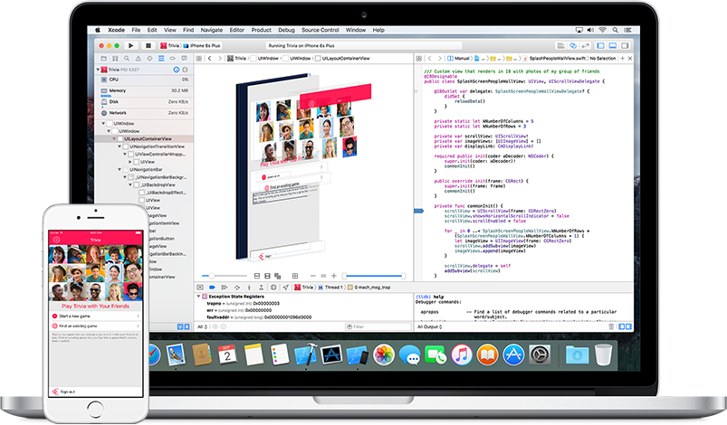
¿Por qué uso Swift?
Notes:
Interés de grande compañias como Google, IBM y Facebook en el lenguaje.
Es un lenguaje moderno
Community Driven
Para programadores que viene desde Objective-C con experiencia en otros lenguajes como JS, C# y Ruby
Fácil de aprender y entender
Esfuerzos en la actualidad para usarlo tanto Server side como Android
Xcode
Co-exists with Objective-C

Slide 8
Vamos a escribir algo de código
Notes:
CLASES
CONDICIONALES, BUCLES, GUARD, DEFER, INITIALIZERS, ETC.
ESTRUCTURAS
PROTOCOLOS
COOL FEATURES

Slide 9
Recursos
https://swift.org/
https://github.com/apple/swift
https://github.com/apple/swift-evolution
https://github.com/uraimo/Awesome-Swift-Playgrounds#learning-swift
www.raywenderlich.com
https://swiftlang.ng.bluemix.net/#/repl
https://developer.apple.com/videos/play/wwdc2016/415/

Slide 10
Gracias por su atención

